Slide 1
ECE411 MP4 Presentation
AG0/5
Simon Ge, Ben Wu, Youyou Yu
ziningg2, yulun4, youyouy2

Slide 2
Overview
5-stage in-order pipeline processor
Cache
Fully parameterized cache
Victim Cache
Branch Predictor
Local branch history table
Global branch history table
RISC-V M-extension
Dadda Multiplier
Basic Divider

Slide 3
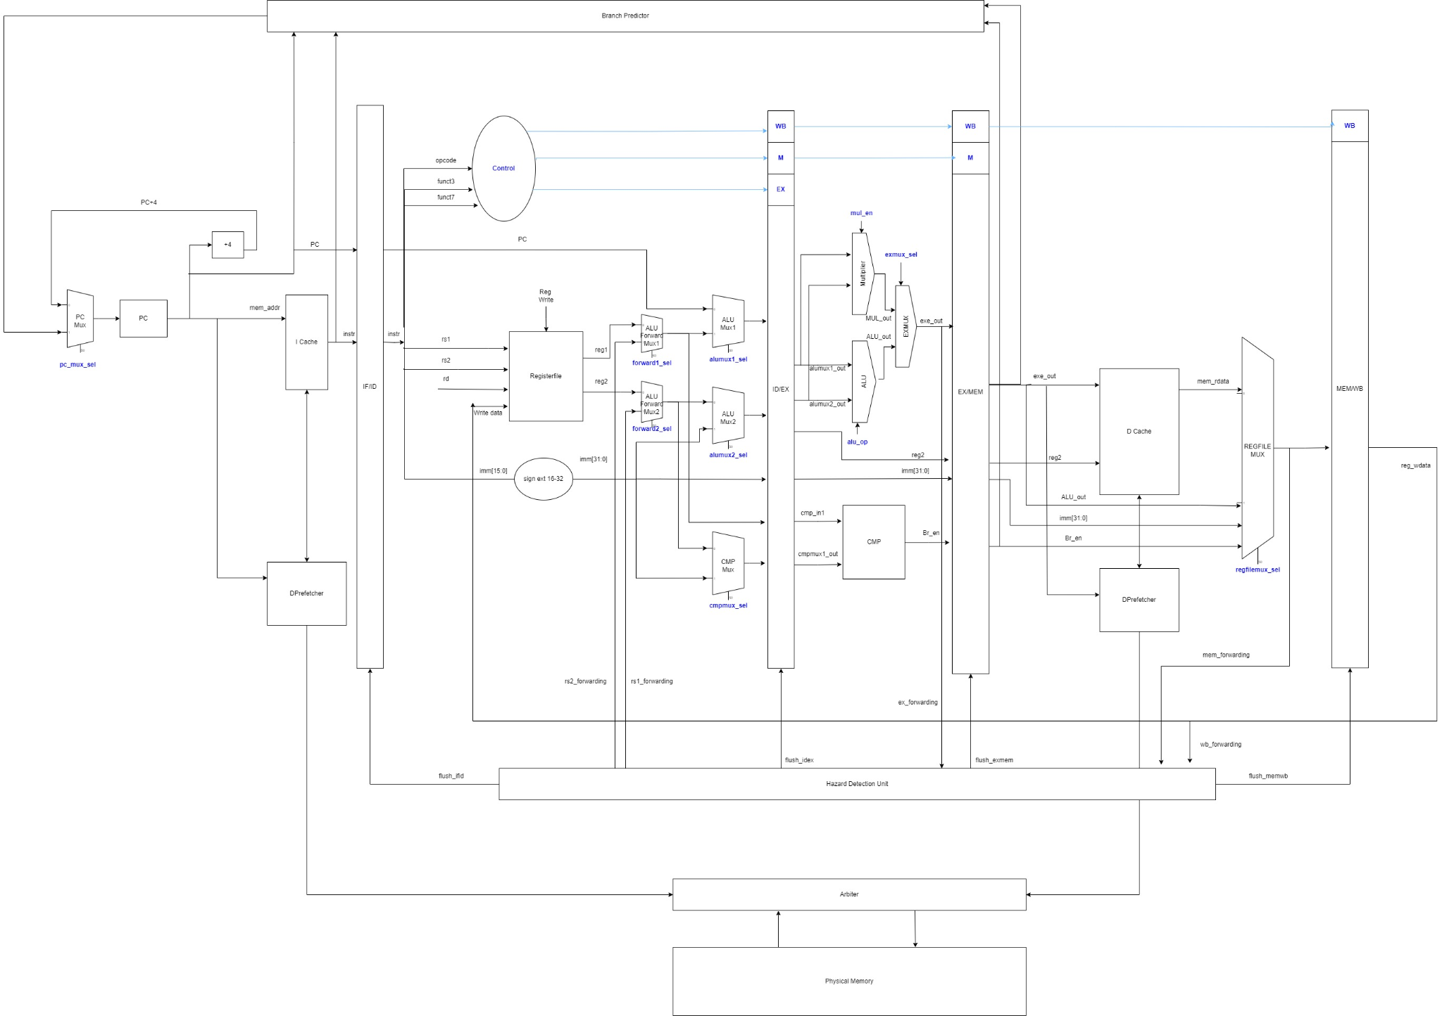

Slide 4
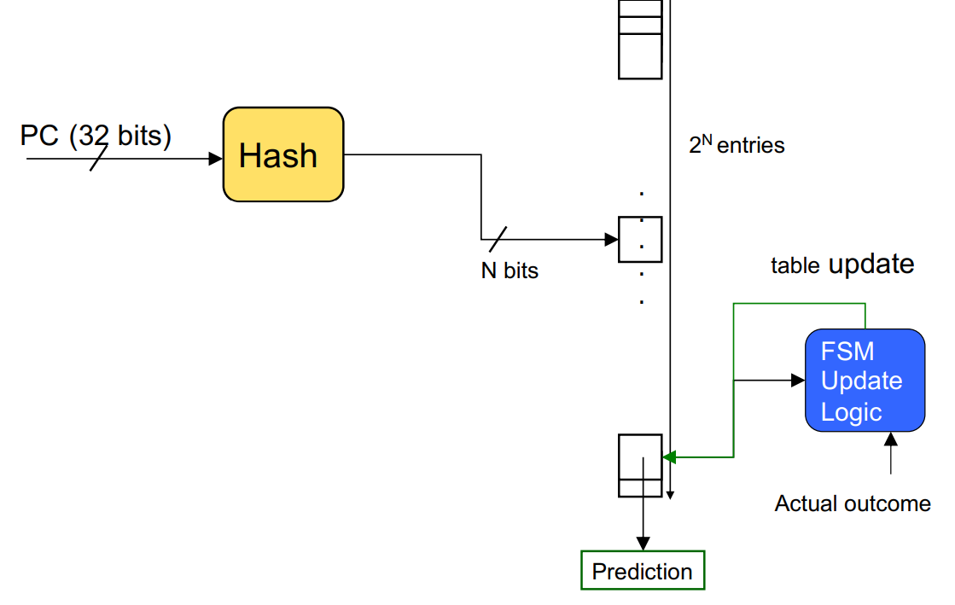
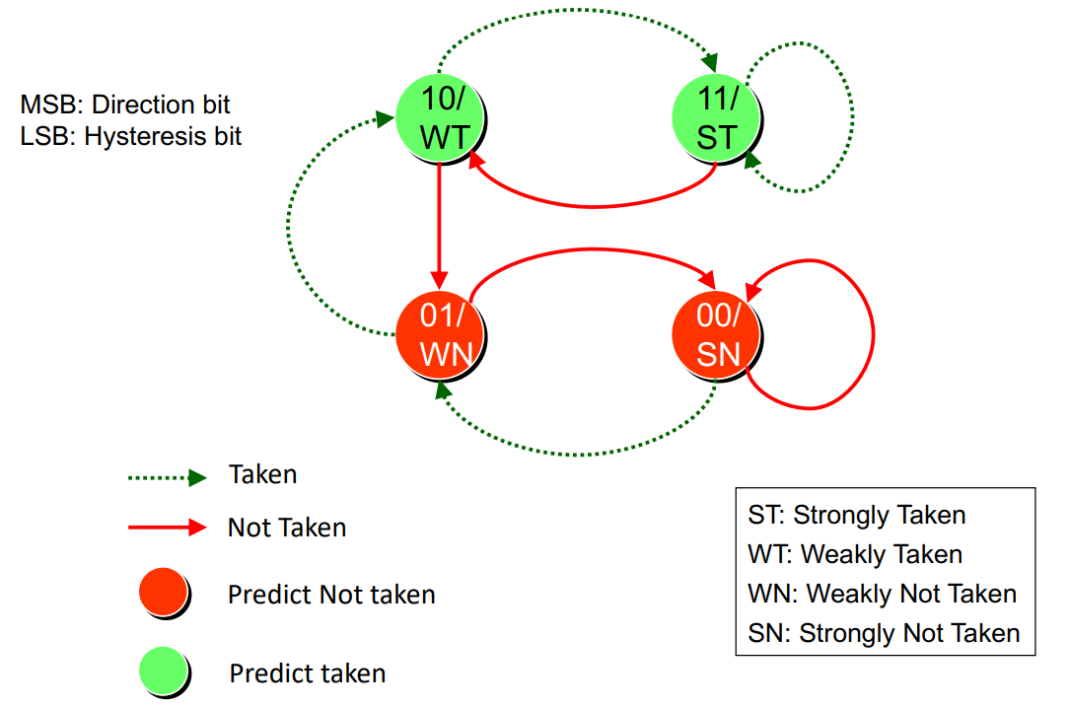
Branch Predictor
Local branch history table + 2-bit counter predictor
Local branch history table size: 32
Pattern history table size: 64
Global branch history table + 2-bit counter predictor
Pattern history table size: 2048

Slide 5
Branch Predictor Performance
 | # correct prediction | Prediction Accuracy | Speed up
Static predictor | 79378 / 205516 | 0.385751
Local branch predictor | 154078 / 205516 | 0.749713 | 1.9694x
Global branch predictor | 154390 / 205516 | 0.751231 | 1.9474x
Table 1: Performance on RV32I-Coremark
 | # correct prediction | Prediction Accuracy | Speed up
Static predictor | 27448 / 59474 | 0.461513
Local branch predictor | 44973 / 59474 | 0.756179 | 1.6384x
Global branch predictor | 48009 / 59474 | 0.807227 | 1.7490x
Table 2: Performance on RV32IM-Coremark

Slide 6
RISC-V M Extension
Implemented new operations:
Multiply: MUL, MULH, MULHSU, MULHU
Divide: DIV, DIVU
Remainder: REM, REMU

Slide 7
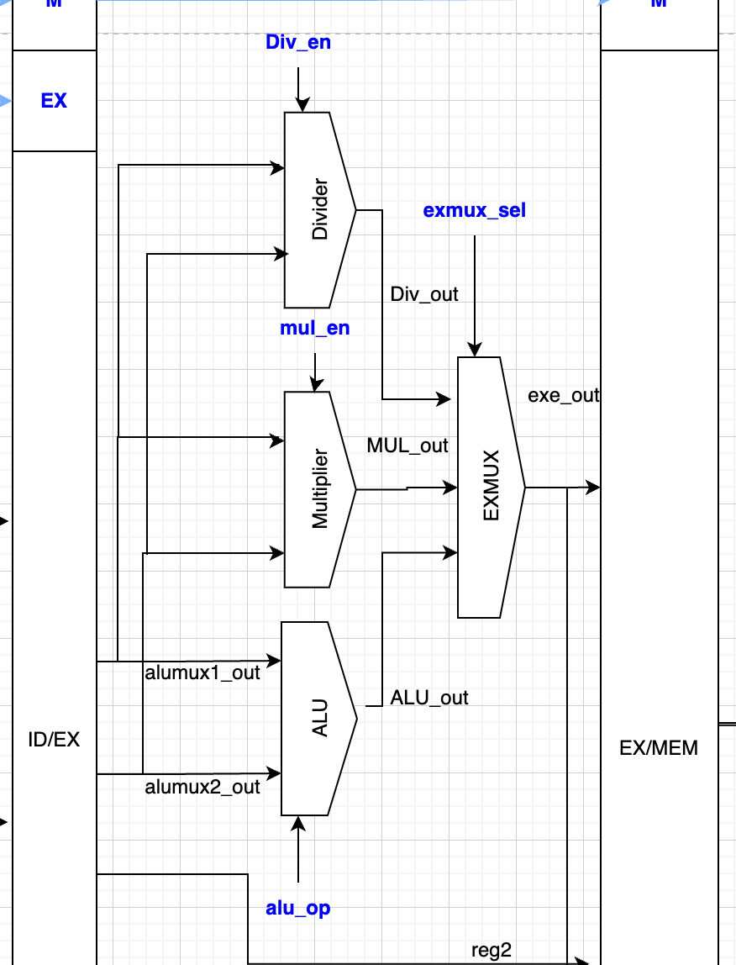
RISC-V M Extension
Design:
RS1 and RS2 feed into ALU, Multiplier, and Divider
Div_en, Mul_en, and alu_op coming from control signals
An extra EXEMUX to select results
div_resp and mul_resp can stall pipeline
Forwarding from MEM, WB stages to ID

Slide 8
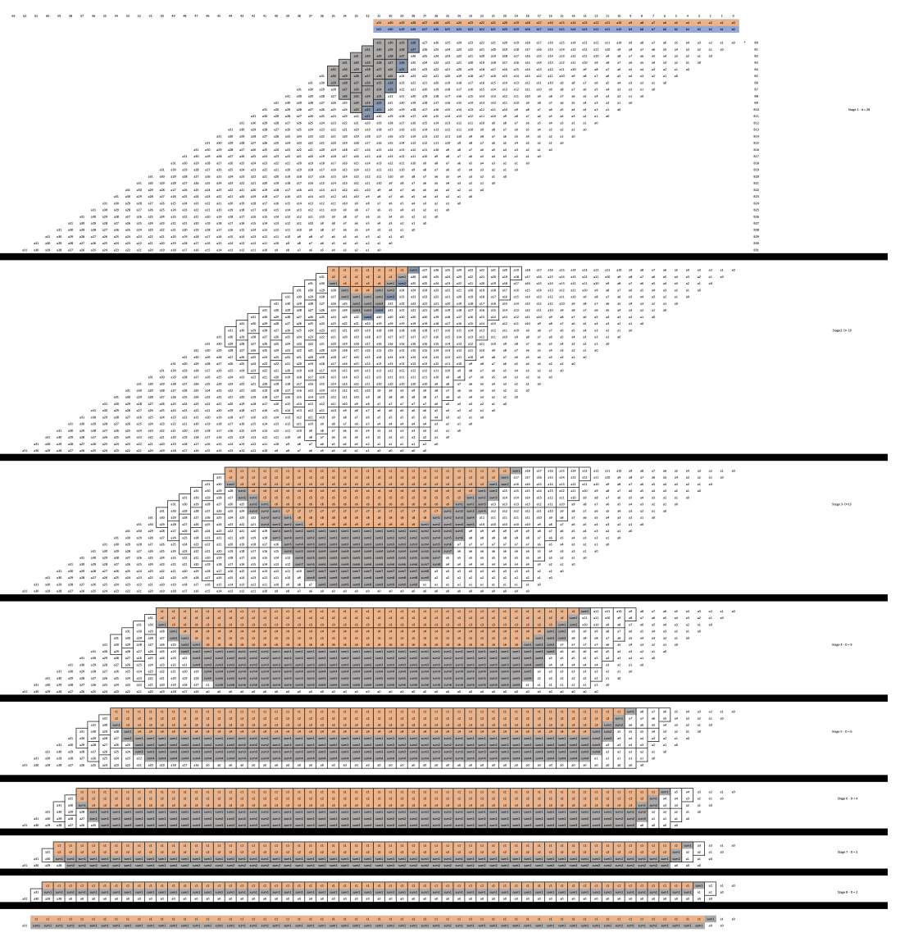
RISC-V M Extension
Dadda Multiplier Design:
Partial product reduction in 8 stages
In each stage, all full-adders and half-adders perform additions in parallel
HDL generated by a python script
FSM states: prepare, reduction, done

Slide 9
RISC-V M Extension
Dadda Multiplier Advantages:
Minimal critical path: in reduction stage, max delay is just 8 adders propagating in series compare to the traditional add-shift multiplier
Fast performance: any 32 by 32 bits multiplication can be done in 3 cycles
Great power efficiency: only adders are used, no shifters

Slide 10
RISC-V M Extension
Basic Divider:
Subtract based divider
Remainder functionality integrated into the divider
Worst case performance determined on dividend and divisor

Slide 11
Cache
Implemented new operations:
Cache Parameterization
Victim Cache

Slide 12
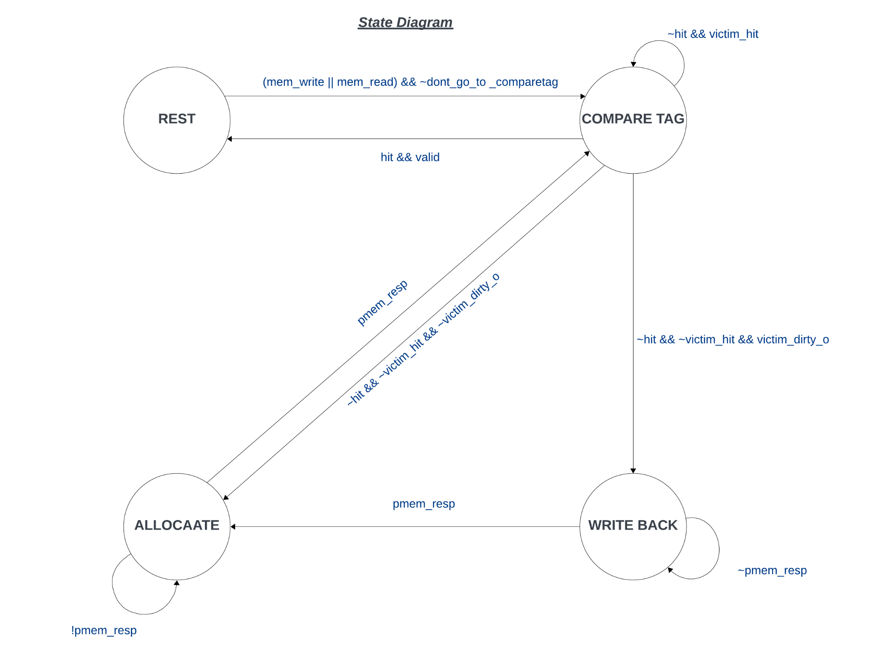
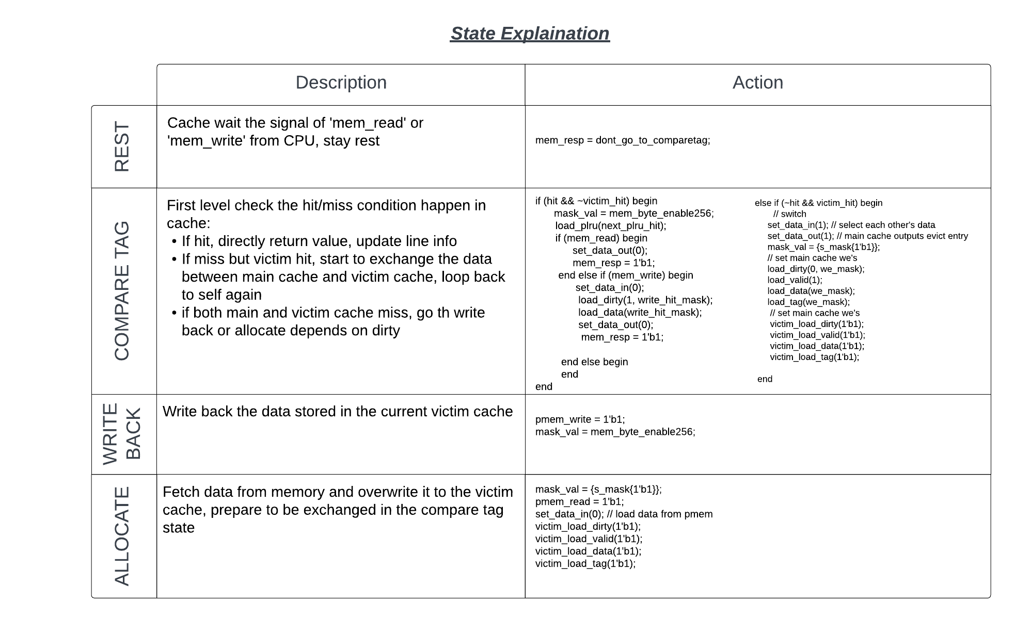
Cache: Victim Cache

Slide 13
Cache: Victim Cache
One thing to notice for “idle” state
If we don’t change anything, there’s a possibility that:
The response of D/I-cache has a 180 phase difference
Then the PC will never be loaded, due to our pipeline proceed logic
So I set up a “don_go_to_compare_tag” signal, and it will be high when:
The same address and I/O operation happens consecutively (always high I-read)
When it stays in “idle” state, give appropriate response based on the “dont_go_to_compare_tag”

Slide 14
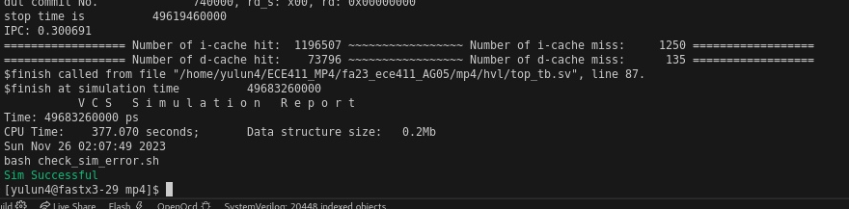
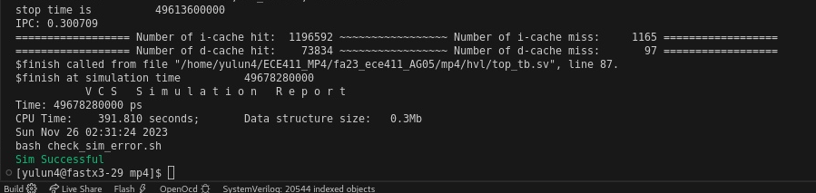
Cache: Victim Cache Comparison
No Victim
With Victim

Slide 15
Cache: Parameterization
Things being parameterized:
Cache-line size
Tag size
# of ways
# of sets

Slide 16
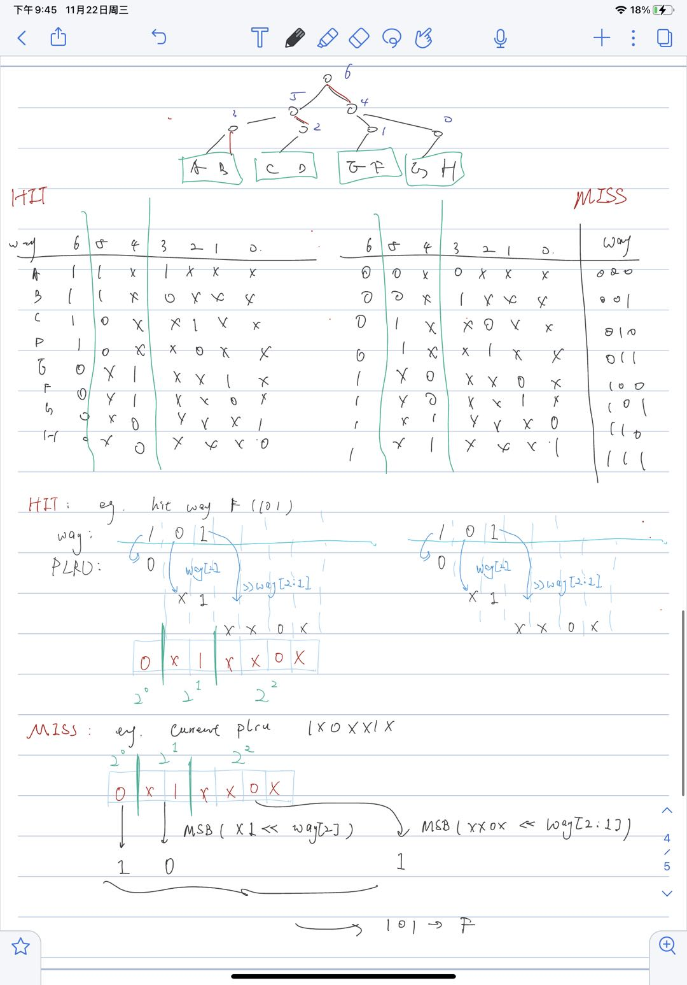
Cache: PLRU generalization equation

Slide 17
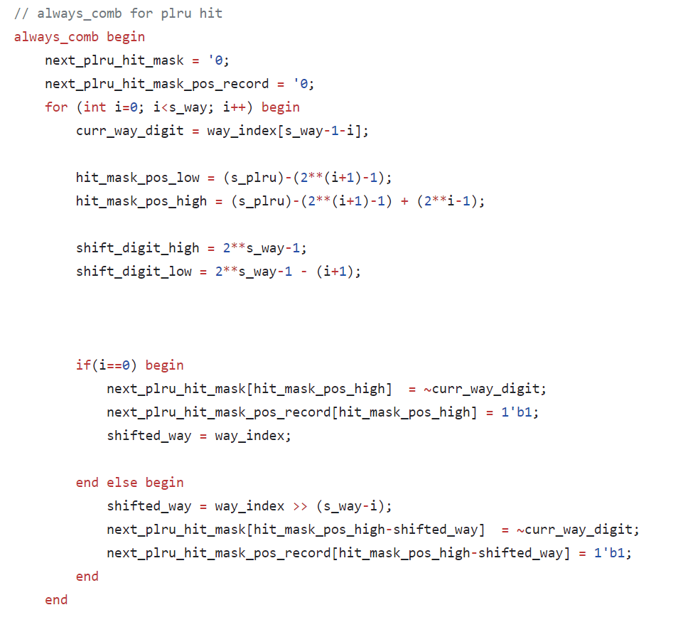
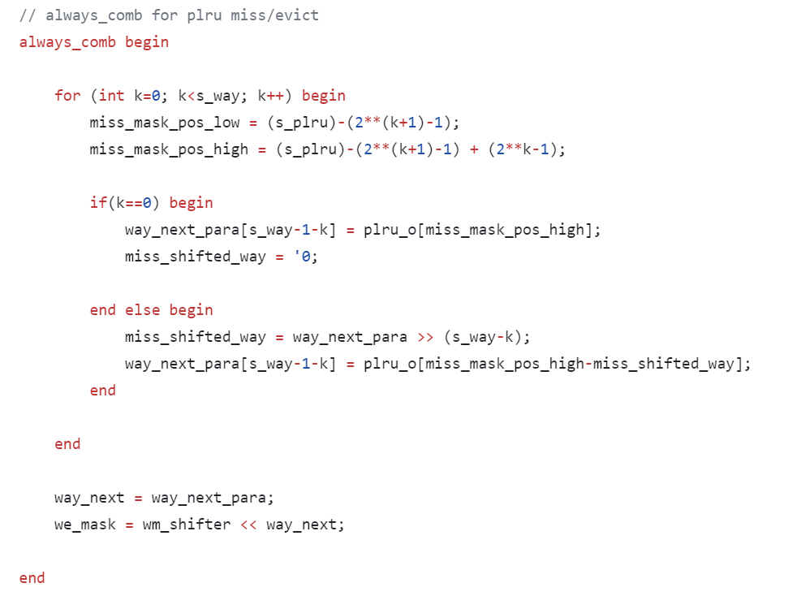
Cache: PLRU generalization equation

Slide 18
Cache: Cache-line Size
Things being done to achieve this:
.py Config:
Re-make the sram verilog file each time we want to change it
CA_adaptor:
Counts and burst a certain times based on parameter
E.g. 128-bit line -> only burst 2 times, each with 64 btis
Bus_adaptor:
Adjust the bandwidth and mem_byte_enable scale
burst_memory.sv:
Change number of burst happens each time we access memory

Slide 19
Thanks!
Team: AG05
Zining (Simon) Ge, Yulun (Ben) Wu, Youyou Yu

